Slide 1
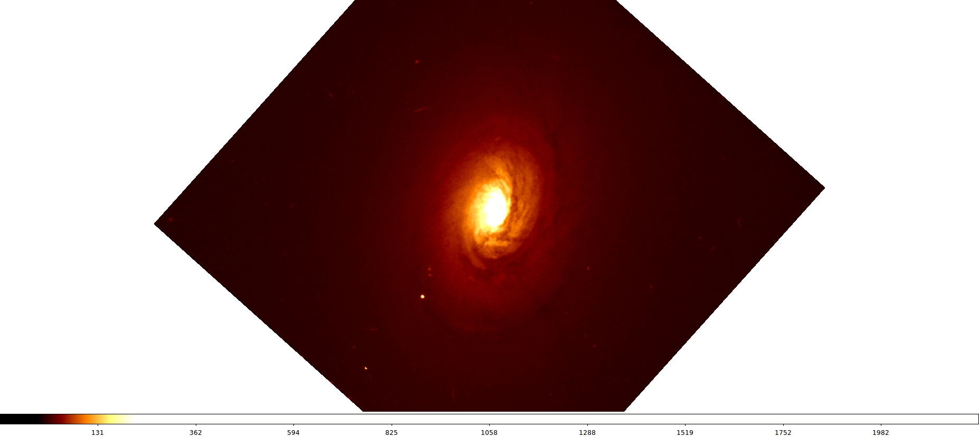
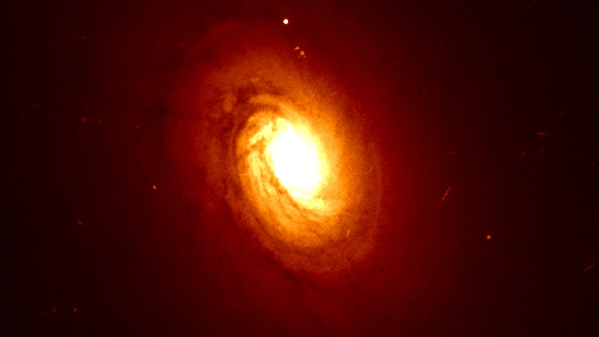
ANALYSIS OF THE AGN OF NGC2110
GROUP 15
ALBERTO MAGARAGGIA
ALBERTO SALVARESE

Slide 2



NGC 2110
Name: NGC 2110
Equatorial coordinates (RA,dec): 88.047420, -7.456212
Redshift: 0.0078
Luminosity distance: 34.5 Mpc
Diameter: 26.61 kpc
Morphology: SAB0^-
Optical, Image from HST

Slide 3
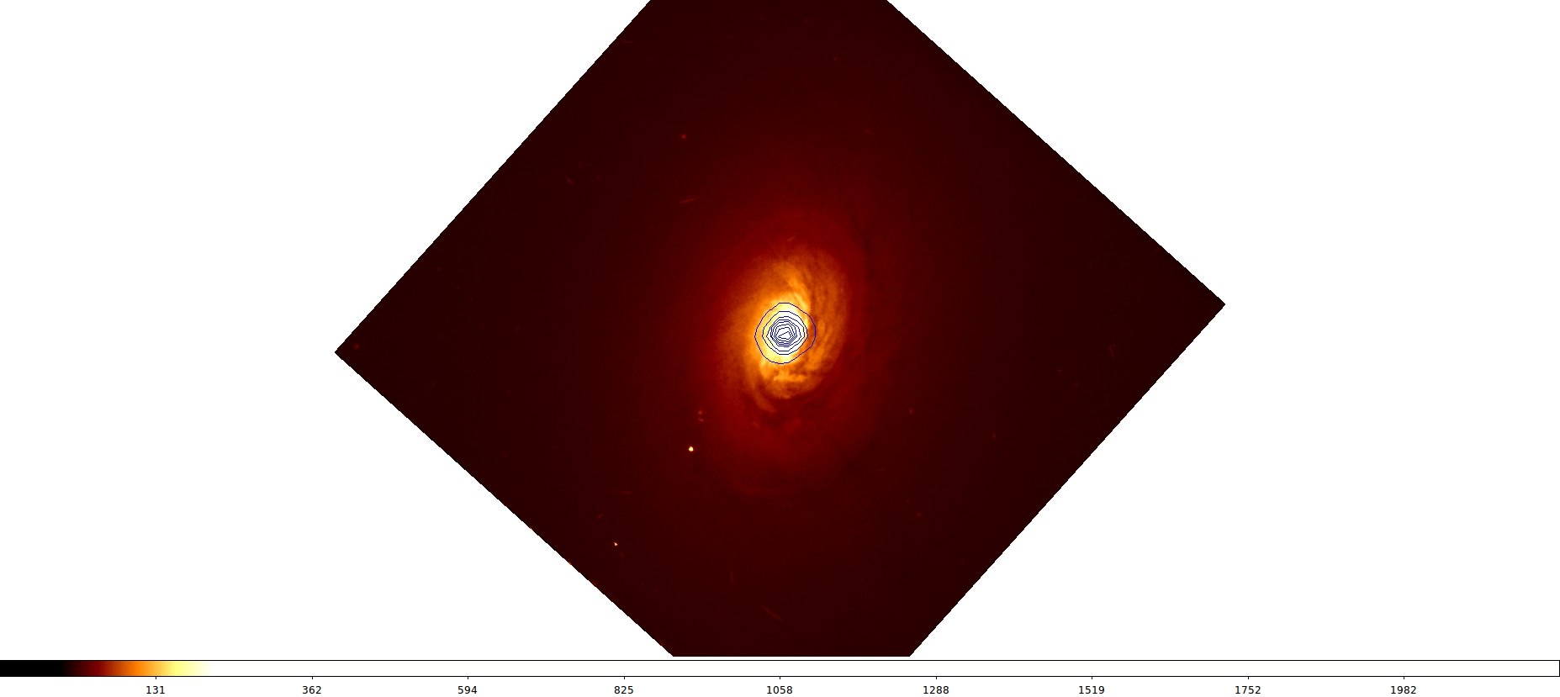
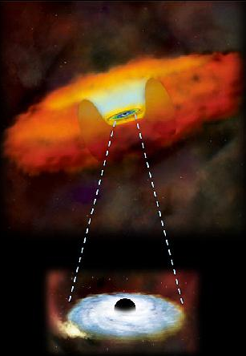
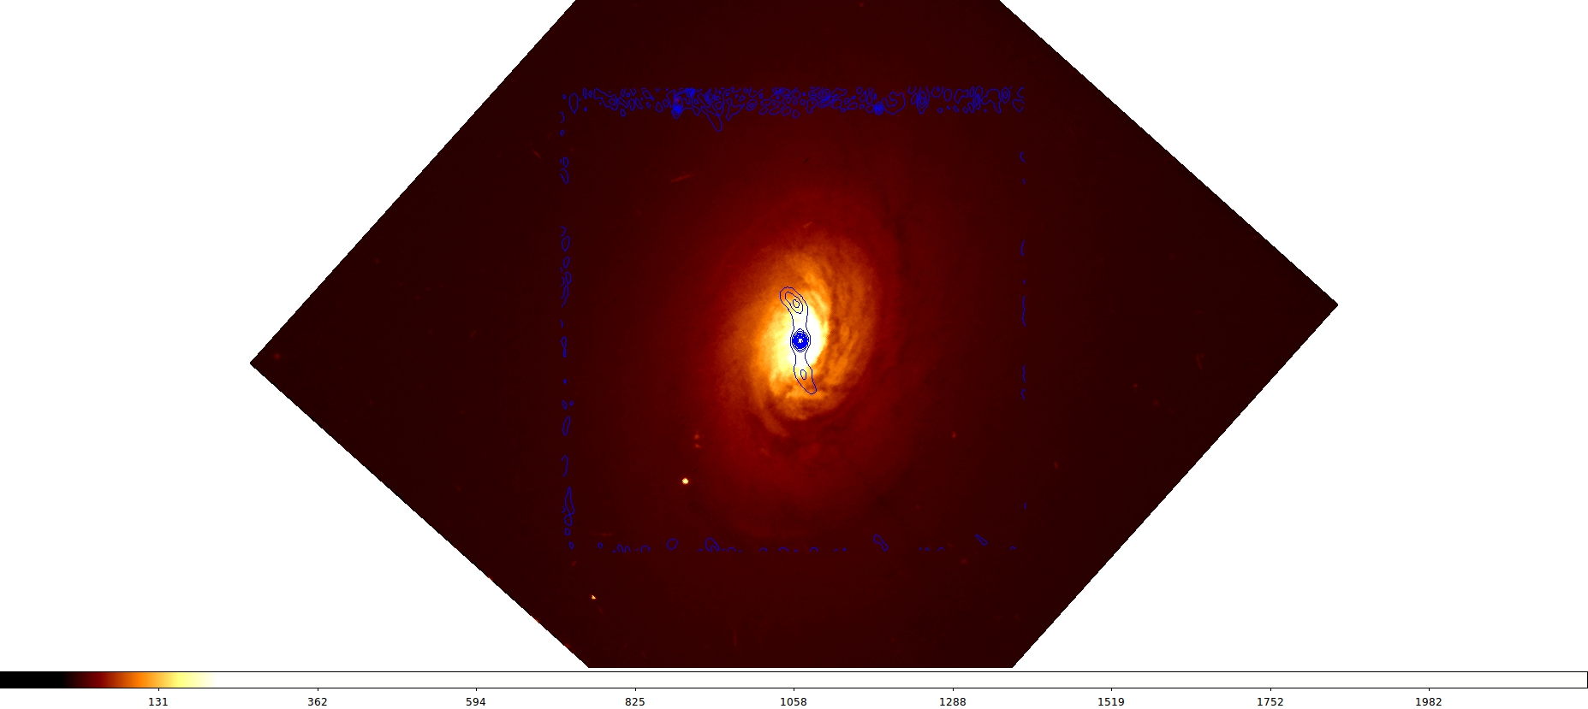
AGNs
Radio contour
X contour
E
N
NGC 2110 is a Seyfert 2 galaxy
Artist’s concept

Slide 4
CHANDRA
HIGH RESOLUTION MIRROR ASSEMBLY
SPACECRAFT
MODULE
ENERGY RANGE:
0.1-10 KeV
SOLAR ARRAY
HIGH RESOLUTION CAMERA
ADVANCED CCD
IMAGING SPECTROMETER
OPTICAL BENCH
Artist’s concept

Slide 5
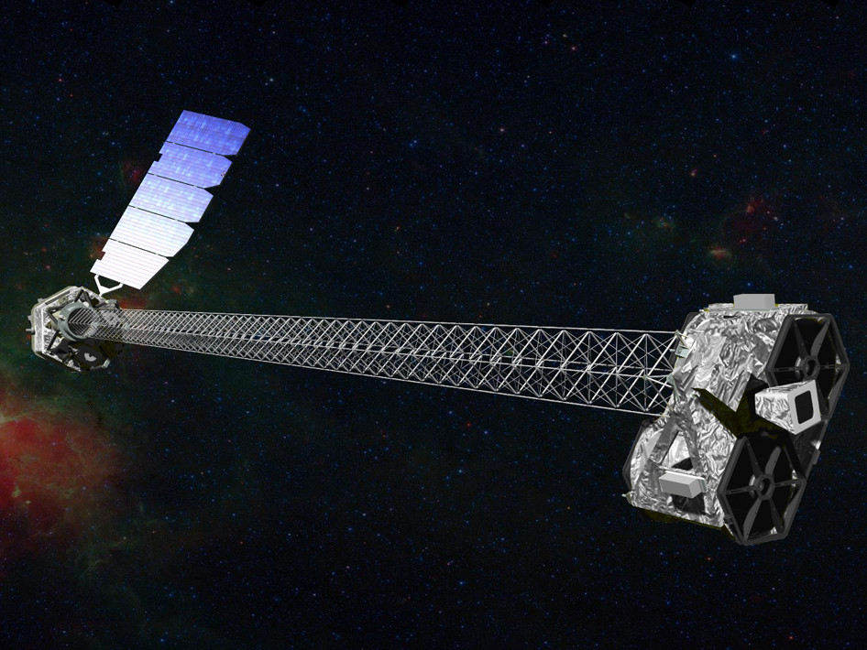
NuSTAR
SOLAR ARRAY
ENERGY RANGE:
3-79 KeV
X-RAY OPTICS
MAST
SHIELDED FOCAL
PLANE DETECTORS
STAR TRACKER
Artist’s concept

Slide 6
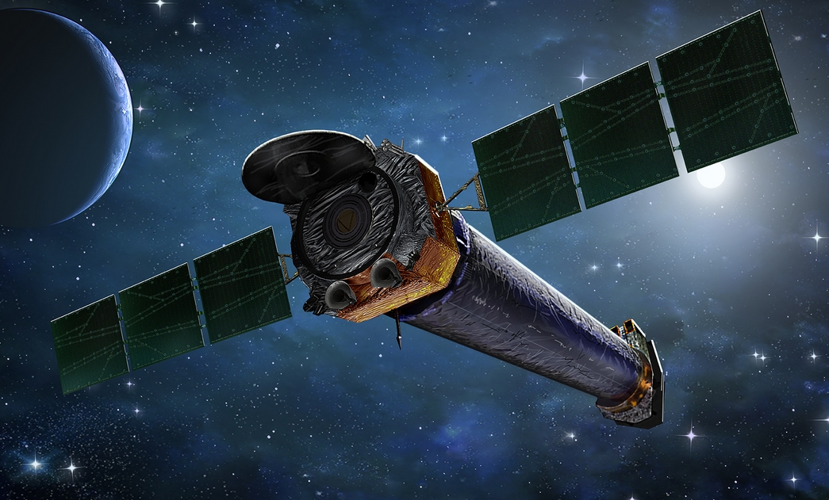
Chandra and NuSTAR specifications
Telescope
Launched on
Energy range
Angular resolution (FWHM)
Spectral resolution (FWHM)
Sensitivity
Temporal resolution
Chandra
July 23, 1999
0.1-10 keV
0.5"
120 eV (ACIS at 6 keV)
4 × 10⁻¹⁵ ergs cm⁻² s⁻¹ (0.4-6 keV)
3 ms
NuSTAR
June 13, 2012
3-79 keV
18"
400 eV (at 10 keV)
2 x 10⁻¹⁵ erg cm⁻² s ⁻¹ (6-10 keV)
2 μs

Slide 7
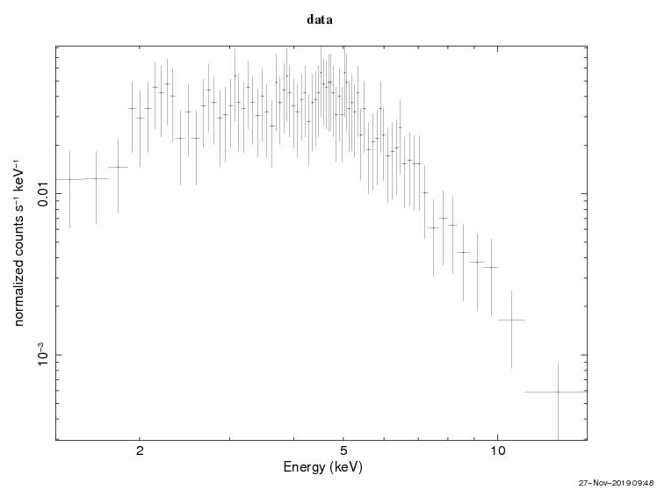
ObsID 3418 e1
Instrument: Chandra
Exposure time: 80 ks
Date: 20 December 2001
Dearth of data!

Slide 8
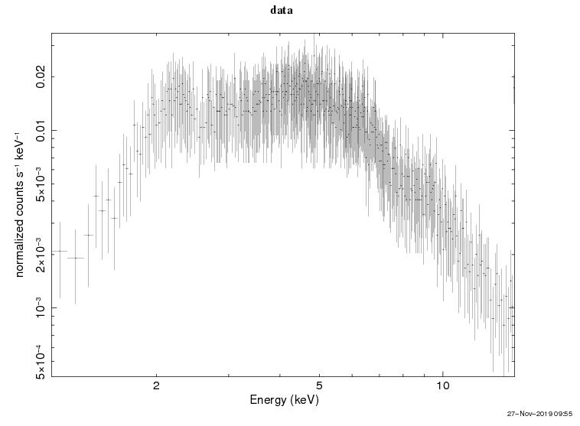
ObsID 3418 e2
Instrument: Chandra
Exposure time: 80 ks
Date: 20 December 2001

Slide 9
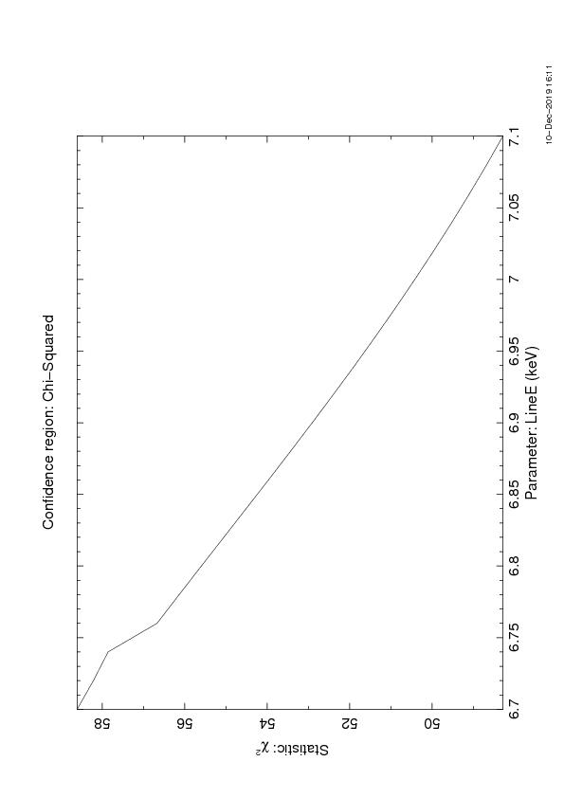
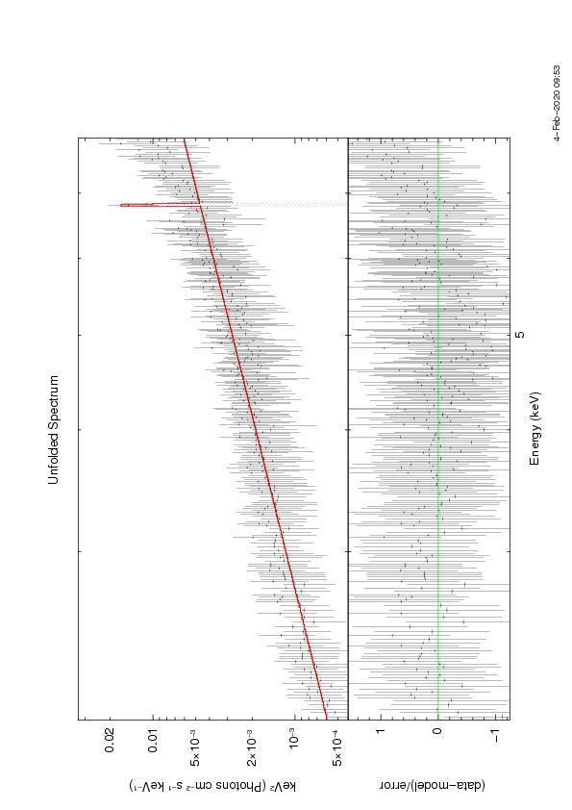
ObsID 3418 e2: Analysis
Range considered: 2-8 keV
Best fit model: WABS(powerlaw+gauss)
NO !
Best fit parameters
Line: 6.81 ± 0.06 keV
Element: Magnesium (Mg Kα)
σ : 2.08 x 10⁻⁶ ± 3
Χ² : 0.2347
N_{H} : (2.71 ± 0.81 ) x 10²² atoms cm⁻²
Γ : 0.30 ± 0.08
Γ_{NORM} : (1.81 ± 0.27) x 10⁻⁴
Is it a real line?

Slide 10
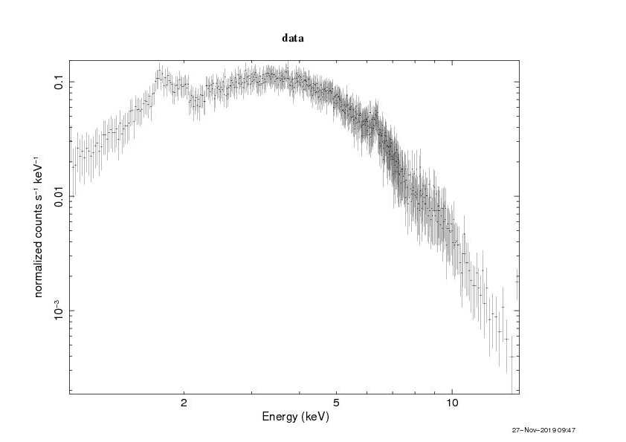
ObsID 883
Instrument: Chandra
Exposure time: 50 ks
Date: 22 April 2000

Slide 11
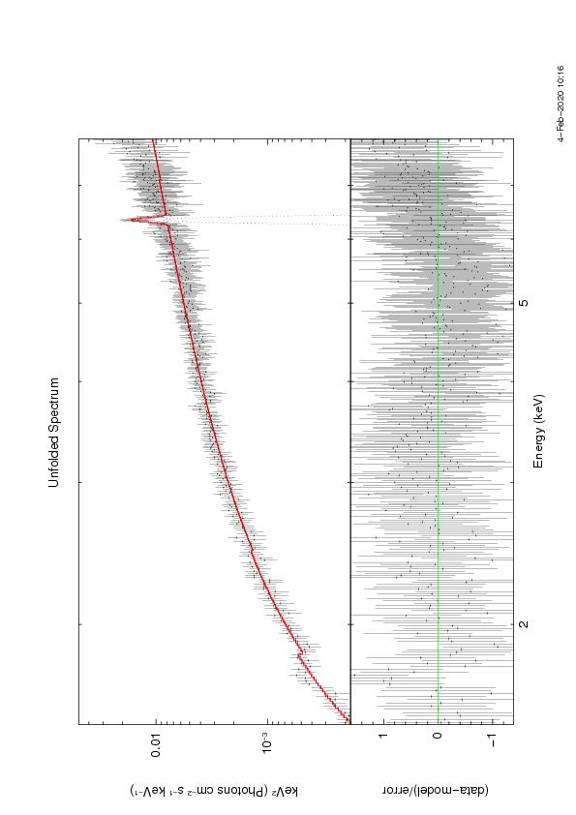
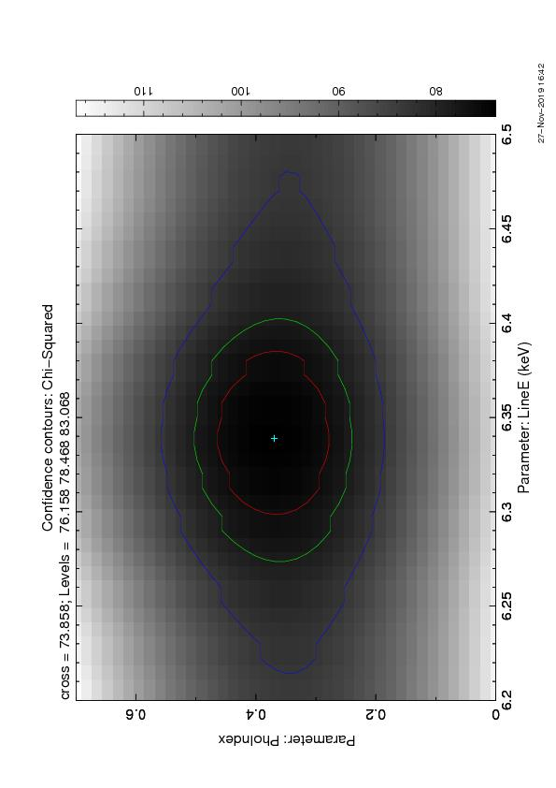
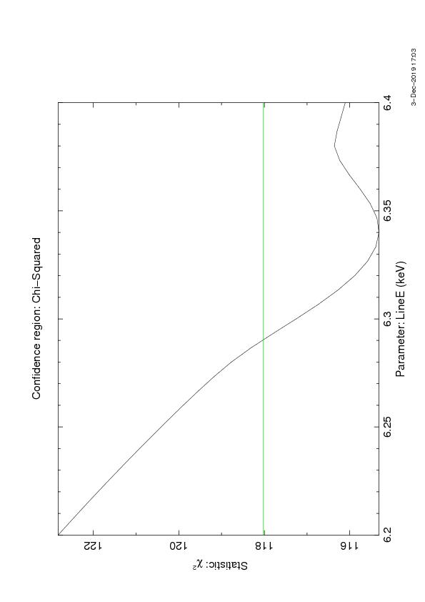
ObsID 883
Range considered: 1.5-8 keV
Best fit model: WABS(powerlaw+gauss)
Best fit parameters
Line: 6.34 ± 0.03 keV
Element: Iron (Fe Kα)
σ: (3.16 ± 0.80) x 10⁻²
Χ² : 0.2752
N_{H} : (2.34 ± 0.15) x 10²² atoms cm⁻²
Γ : 0.71 ± 0.07
Γ_{NORM} : (7.74 ± 0.86) x 10⁻⁴
Flux: 5.59 x 10⁻¹³ erg cm⁻² s⁻¹

Slide 12
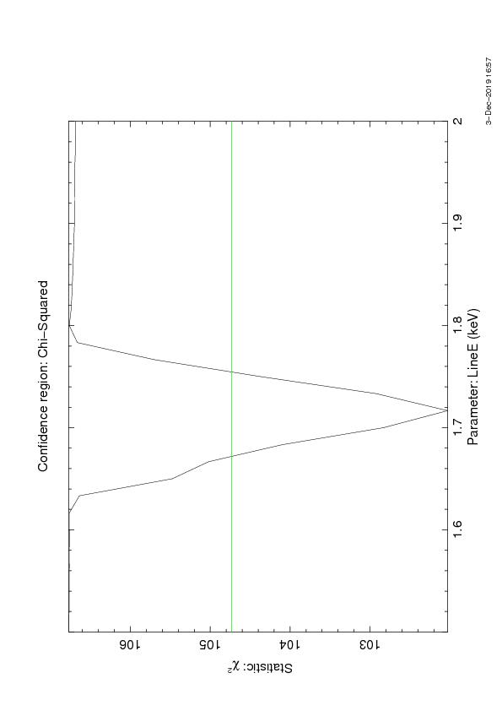
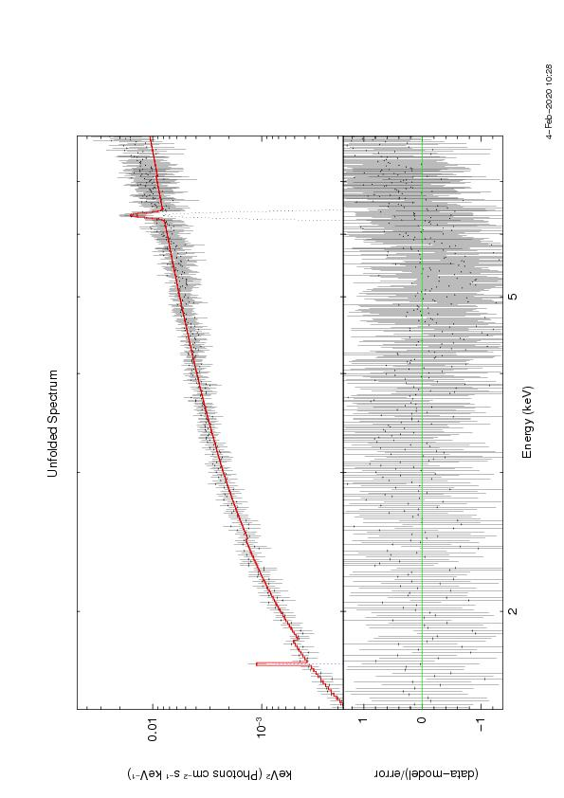
ObsID 883
Range considered: 1.5-8 keV
Best fit model: WABS(powerlaw+gauss)
Best fit parameters
Line: 1.71 ± 0.03 keV
Element: Silicon (Si Kα)
σ: 1.45 x 10⁻³ ± 0.56
Χ² : 0.2671
N_{H} : (2.48 ± 0.17) x 10²² atoms cm⁻²
Γ : 0.74 ± 0.07
Γ_{NORM} : (8.17 ± 0.95) x 10⁻⁴
Flux: 5.29 x 10⁻¹⁴ erg cm⁻² s⁻¹

Slide 13
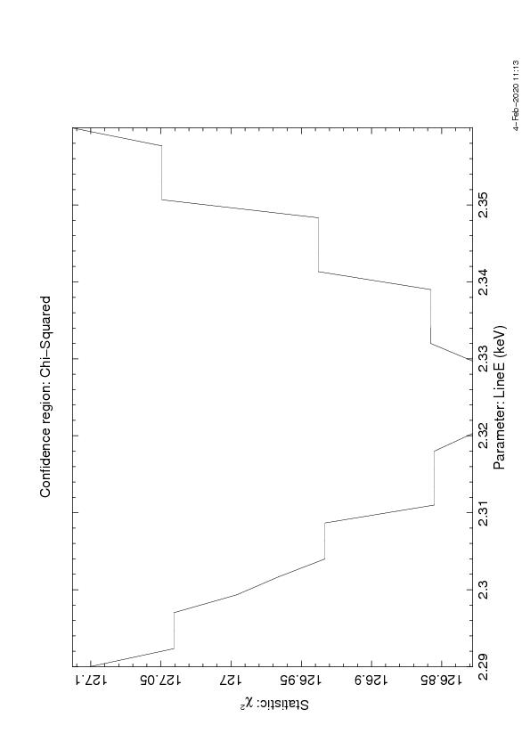
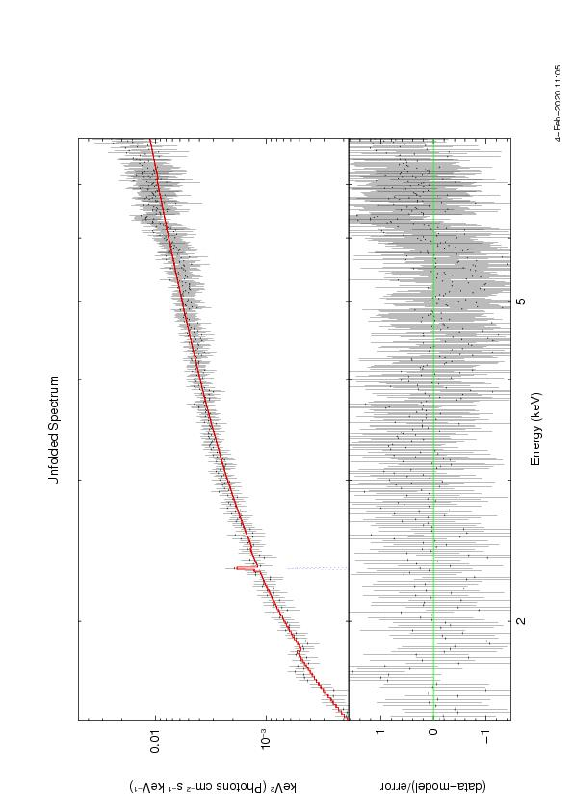
ObsID 883
Range considered: 1.5-8 keV
Best fit model: WABS(powerlaw+gauss)
Best fit parameters
Line: 2.32 ± 0.09 keV
Element: Sulfur (S Kα)
σ: 1.91 x 10⁻³ ± 0.58
Χ² : 0.3027
N_{H} : (2.24 ± 0.15) x 10²² atoms cm⁻³
Γ : 0.65 ± 0.06
Γ_{NORM} : (7.03 ± 0.77) x 10⁻⁴
Flux: 1.92 x 10⁻¹⁴ erg cm⁻² s⁻¹

Slide 14
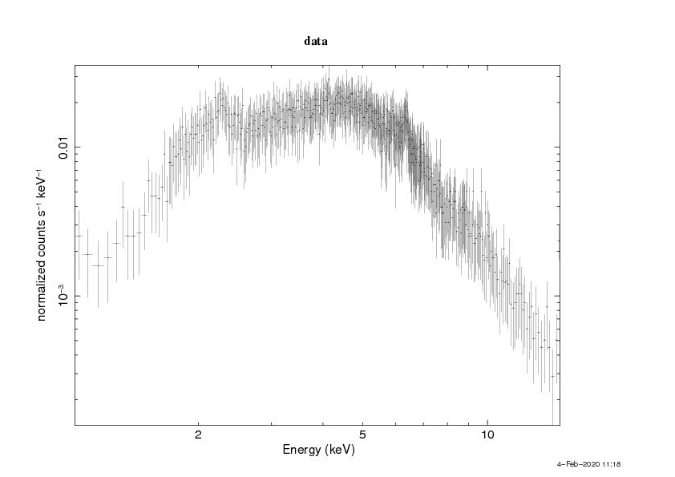
ObsID 4377
Instrument: Chandra
Exposure time: 100 ks
Date: 5 March 2003

Slide 15
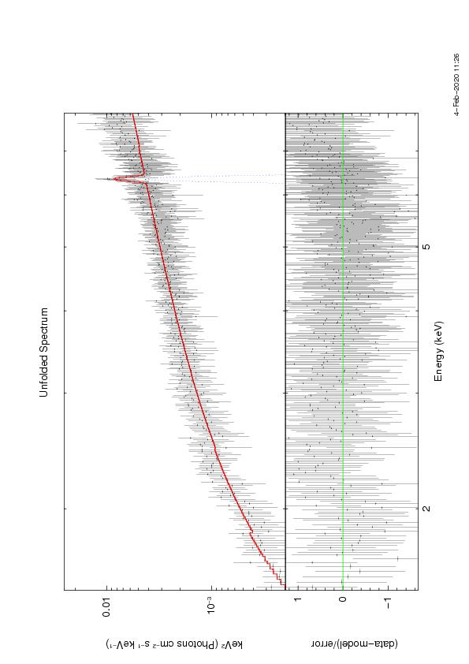
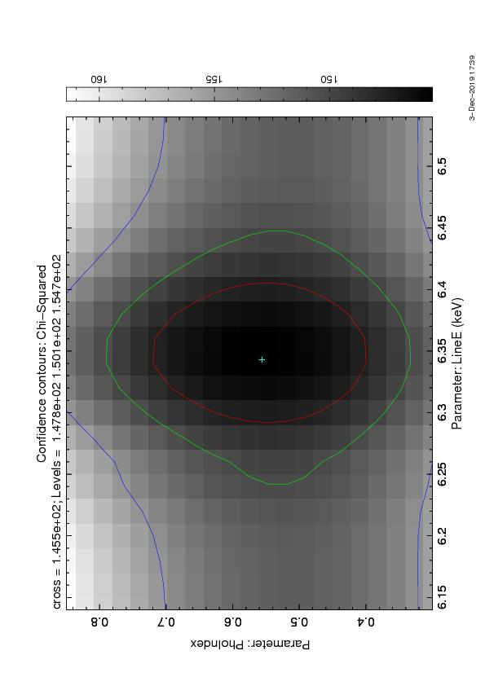
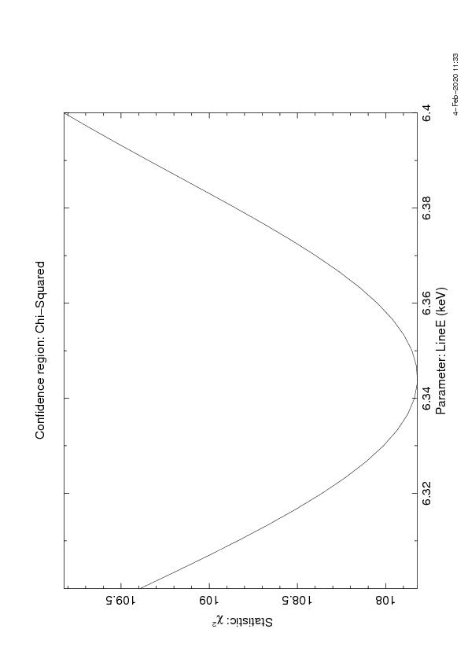
ObsID 4377
Range considered: 1.5-8 keV
Best fit model: WABS(powerlaw+gauss)
Best fit parameters
Line: 6.34 ± 0.04 keV
Element: Iron (Fe Kα)
σ: (3.65 ± 1.12) x 10⁻²
Χ² : 0.2709
N_{H} : (1.61 ± 0.29) x 10²² atoms cm⁻²
Γ : 1.07 ± 0.13
Γ_{NORM} : (4.55 ± 0.84) x 10⁻⁴
Flux: 3.38 x 10⁻¹³ erg cm⁻² s⁻¹

Slide 16
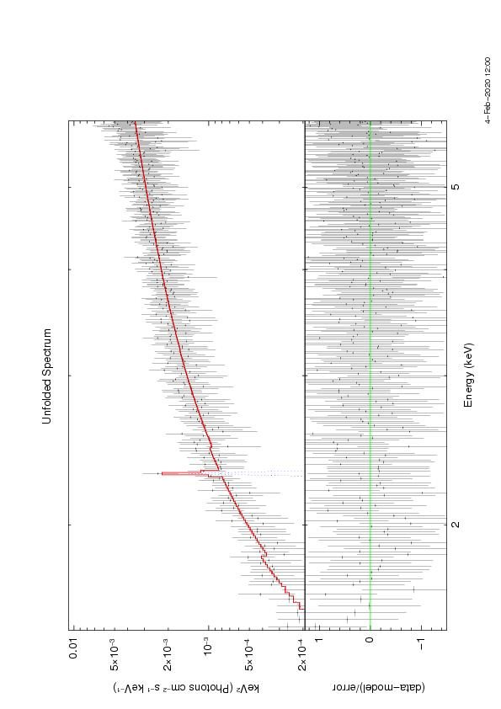
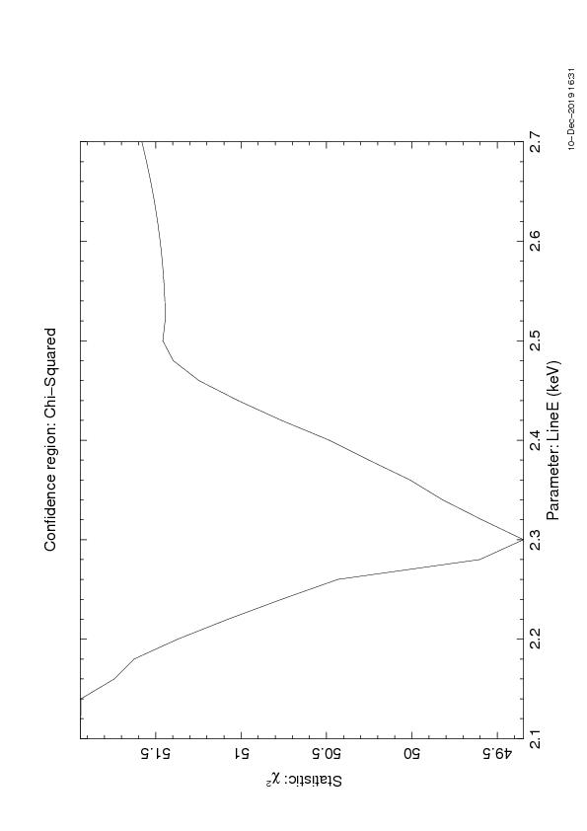
ObsID 4377
Range considered: 1.5-6 keV
Best fit model: WABS(powerlaw+gauss)
Best fit parameters
Line: 2.30 ± 0.04 keV
Element: Sulfur (S Kα)
σ: 3.88 x 10⁻³ ± 0.17
Χ² : 0.2282
N_{H} : (2.47 ± 0.38) x 10²² atoms cm⁻²
Γ : 1.02 ± 0.14
Γ_{NORM} : (6.69 ± 1.53) x 10⁻⁴
Flux: 7.10 x 10⁻¹⁴ erg cm⁻² s⁻¹

Slide 17
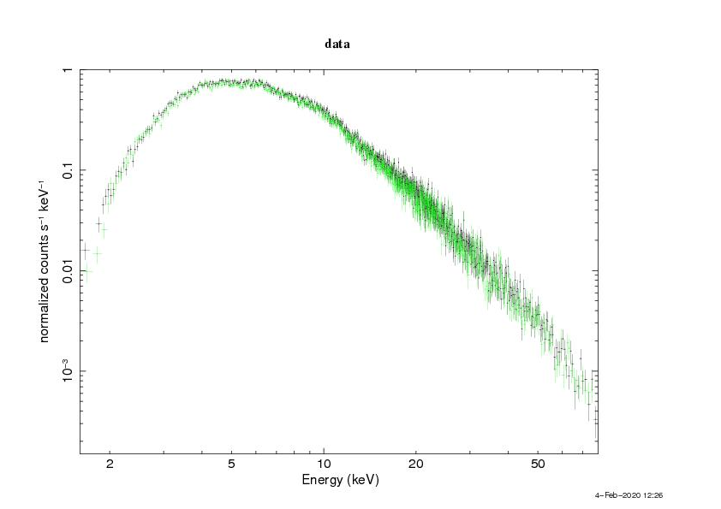
ObsID 60061061002
Instrument: NuStar
Exposure time: 15.5 ks
Date: 5 October 2012

Slide 18
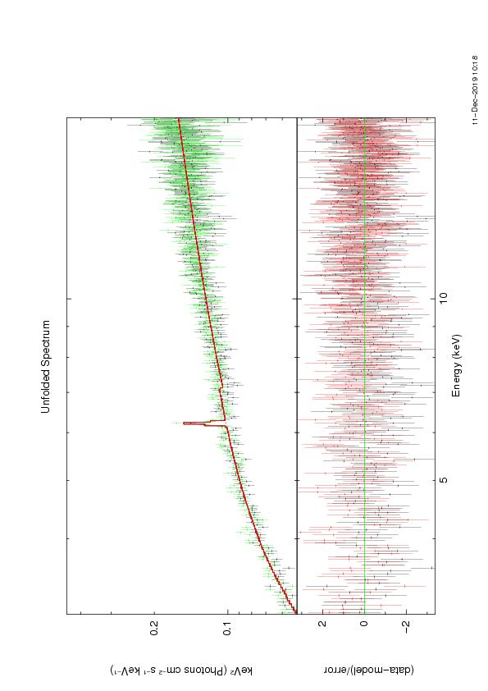
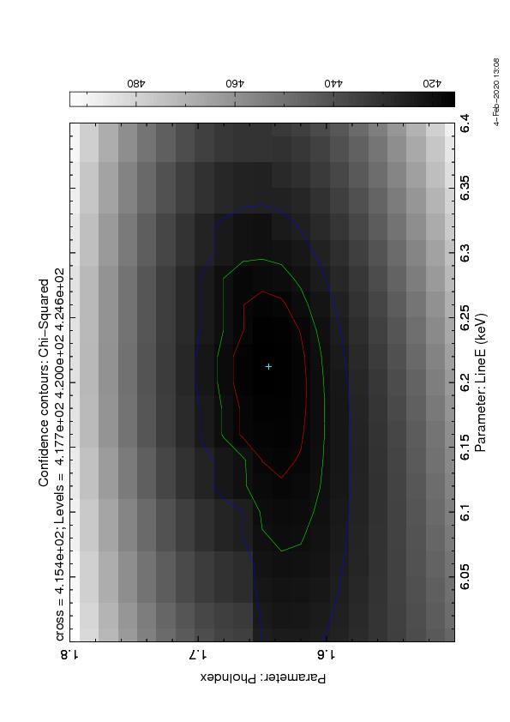
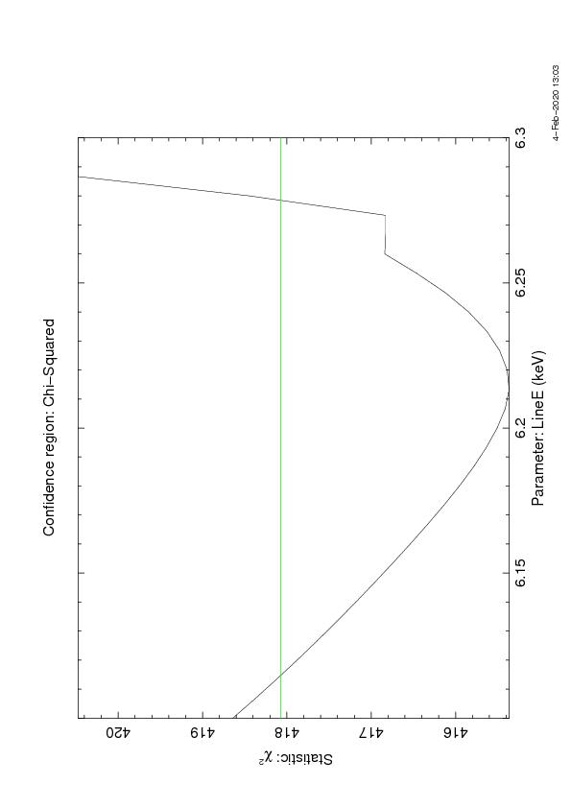
ObsID 60061061002
Range considered:3-13 keV
Best fit model: WABS(powerlaw+gauss)
Best fit parameters
Line: 6.22 ± 0.04 keV
Element: Iron (Fe Kα)
σ: 3.78 x 10⁻² ± 0.13
Χ² : 1.0596
N_{H} : (3.07 ± 0.24) x 10²² atoms cm⁻²
Γ : 1.59 ± 0.02
Γ_{NORM} : (5.09 ± 0.18) x 10⁻²
Flux: 9.78 x 10⁻¹² erg cm⁻² s⁻¹

Slide 19
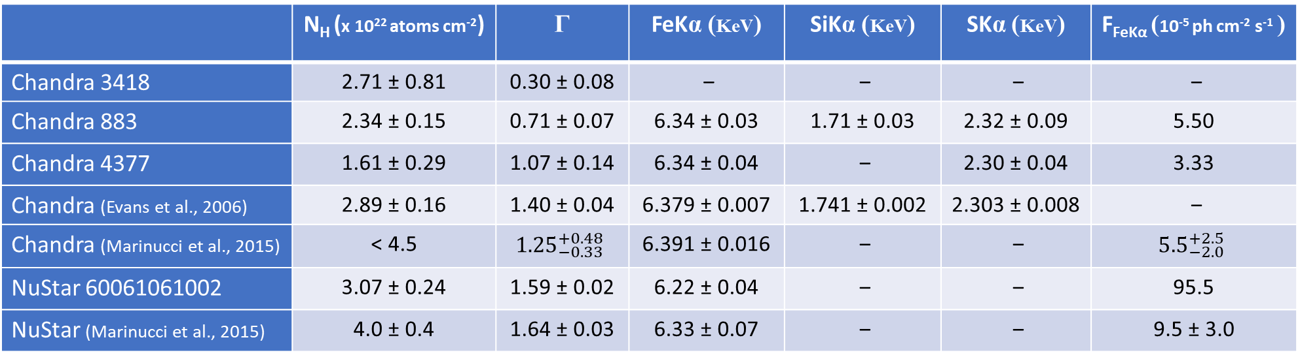
Data comparison
 | N_{H} (x 10²² atoms cm⁻²) | Γ | FeKα (KeV) | SiKα (KeV) | SKα (KeV) | F_{FeKα} (10⁻⁵ ph cm⁻² s⁻¹ )
Chandra 3418 | 2.71 ± 0.81 | 0.30 ± 0.08 | ‒ | ‒ | ‒ | ‒
Chandra 883 | 2.34 ± 0.15 | 0.71 ± 0.07 | 6.34 ± 0.03 | 1.71 ± 0.03 | 2.32 ± 0.09 | 5.50
Chandra 4377 | 1.61 ± 0.29 | 1.07 ± 0.14 | 6.34 ± 0.04 | ‒ | 2.30 ± 0.04 | 3.33
Chandra (Evans et al., 2006) | 2.89 ± 0.16 | 1.40 ± 0.04 | 6.379 ± 0.007 | 1.741 ± 0.002 | 2.303 ± 0.008 | ‒
Chandra (Marinucci et al., 2015) | < 4.5 | $${1.25}_{−0.33}^{+0.48}$$ | 6.391 ± 0.016 | ‒ | ‒ | $${5.5}_{−2.0}^{+2.5}$$
NuStar 60061061002 | 3.07 ± 0.24 | 1.59 ± 0.02 | 6.22 ± 0.04 | ‒ | ‒ | 95.5
NuStar (Marinucci et al., 2015) | 4.0 ± 0.4 | 1.64 ± 0.03 | 6.33 ± 0.07 | ‒ | ‒ | 9.5 ± 3.0

Slide 20
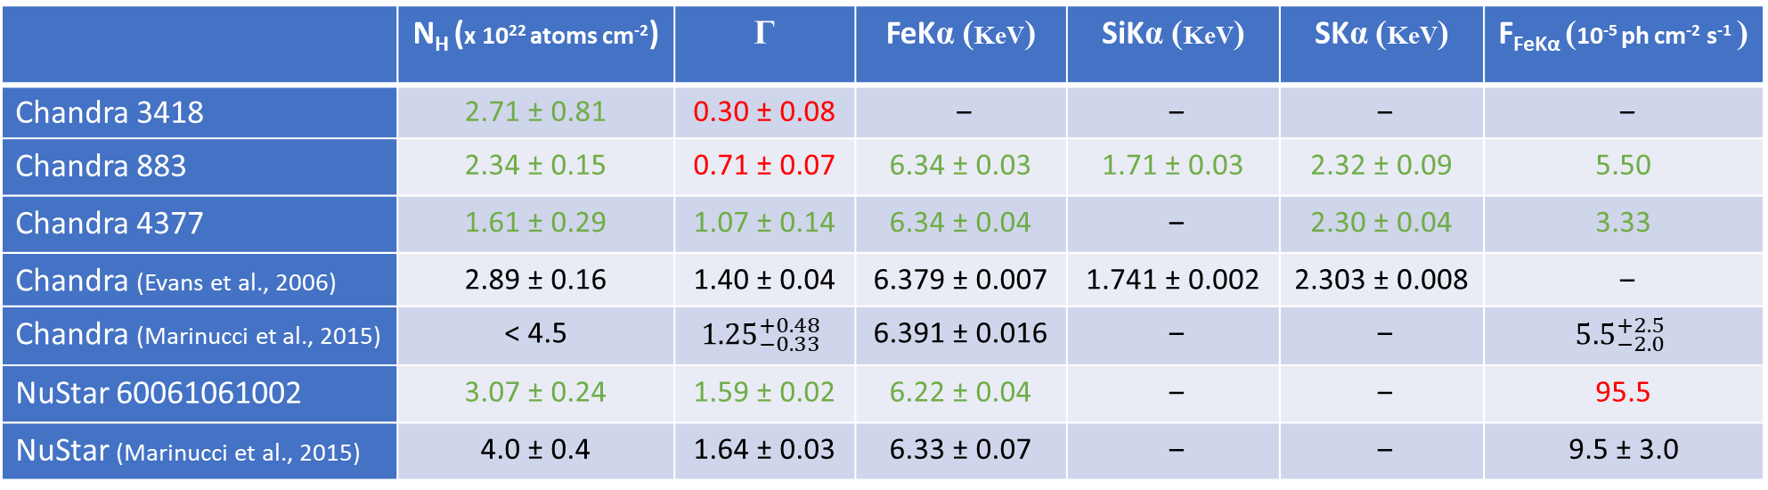
Data comparison
 | N_{H} (x 10²² atoms cm⁻²) | Γ | FeKα (KeV) | SiKα (KeV) | SKα (KeV) | F_{FeKα} (10⁻⁵ ph cm⁻² s⁻¹ )
Chandra 3418 | 2.71 ± 0.81 | 0.30 ± 0.08 | ‒ | ‒ | ‒ | ‒
Chandra 883 | 2.34 ± 0.15 | 0.71 ± 0.07 | 6.34 ± 0.03 | 1.71 ± 0.03 | 2.32 ± 0.09 | 5.50
Chandra 4377 | 1.61 ± 0.29 | 1.07 ± 0.14 | 6.34 ± 0.04 | ‒ | 2.30 ± 0.04 | 3.33
Chandra (Evans et al., 2006) | 2.89 ± 0.16 | 1.40 ± 0.04 | 6.379 ± 0.007 | 1.741 ± 0.002 | 2.303 ± 0.008 | ‒
Chandra (Marinucci et al., 2015) | < 4.5 | $${1.25}_{−0.33}^{+0.48}$$ | 6.391 ± 0.016 | ‒ | ‒ | $${5.5}_{−2.0}^{+2.5}$$
NuStar 60061061002 | 3.07 ± 0.24 | 1.59 ± 0.02 | 6.22 ± 0.04 | ‒ | ‒ | 95.5
NuStar (Marinucci et al., 2015) | 4.0 ± 0.4 | 1.64 ± 0.03 | 6.33 ± 0.07 | ‒ | ‒ | 9.5 ± 3.0
Inside ± 3 times the errors, data obtained are considered consistent with those found in literature

Slide 21
References
- V. Beckmann et al., The elusive radio loud Seyfert 2 galaxy NGC 2110, 2011
- D. J. Rosario et al., An accreting supermassive black hole irradiating molecular gas in NGC 2110, 2019
- A. Marinucci et al., The Seyfert 2 galaxy NGC 2110: hard X-ray emission observed by NuSTAR and variability of the iron Kα line, 2015
- E. Rivers et al., Tracking the complex absorption in NGC 2110 with two Suzaku observations, 2018
- D. A. Evans et al., The Chandra, Hubble Space Telescope, and VLA View of the Circumnuclear Extended Emission in the Narrow Emission Line Galaxy NGC 2110, 2006
- D. A. Evans et al., Probing unification with Chandra HETGs and XMM-Newton epic and RGS spectroscopy of the narrow emission line galaxy NGC 2110, 2007
- P. Padovani et al., Active Galactic Nuclei: what’s in a name?, 2017
- C. G. Mundell et al., Radio-Quiet AGN and the Transient Radio Sky, 2011
Optical, Image from HST

Slide 22
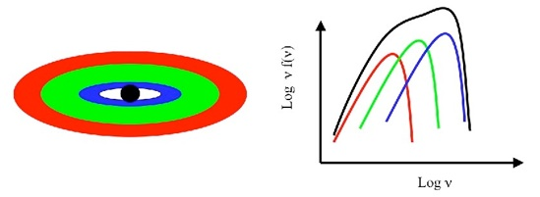
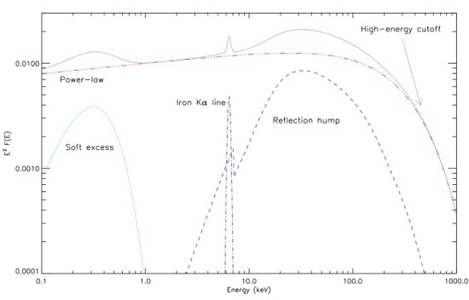
Black body emission from the accretion disk?
Black body contributions from the accretion disk

Slide 23
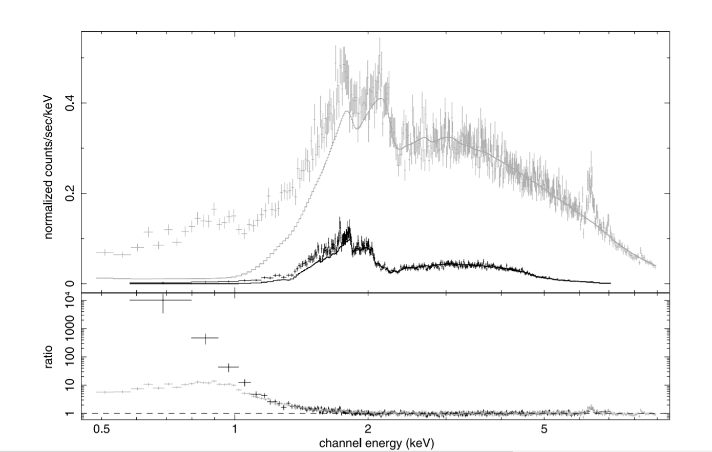
Black body emission from the accretion disk?
XMM-Newton
Small soft excess in Chandra
No reflection hump
Soft excess
Chandra
NEGLIGIBLE DISK
CONTRIBUTION
(Evans et al., 2007, Rivers et al., 2018)
Evans et al., 2007

